Slide 1
论文列表
Guibing Guo, Huan Zhou*, Bowei Chen*, Zhirong Liu, Xiao Xu, Xu Chen, Zhenhua Dong, Xiuqiang He (2020), IPGAN: Generating Informative Item Pairs by Adversarial Sample, IEEE Transactions on Neural Networks and Learning Systems (TNNLS), accepted, (2020-9-25), https://ieeexplore.ieee.org/document/9240960 JCR: Q1; SCI: Q1; CCF: B; IF: 8.793；
R. Ding, B. Chen, G. Guo*, X. Yang (2020). Adversarial Path Sampling for Recommender Systems. IEEE Intelligent Systems, accepted (2020/9/30). JCR: Q1; SCI: Q2; IF: 4.464.
R. Ding, B. Chen, G. Guo*, X. Yang (2020). BiGAN: Generating a Group of Items with Bidirectional Generative Adversarial Networks. In: Proceedings of the 20th SIAM International Conference on Data Mining (SDM), pp. 82-90.
S. Zhai, G. Guo*, F. Yuan, Y. Liu, X. Wang (2020). VSE-fs: Fast Full-Sample Visual Semantic Embedding. IEEE Intelligent Systems, accepted (2020/3/7). JCR: Q1; SCI: Q2; IF: 4.464.
S. Qu, G. Guo*, Y. Liu, Y. Yao, W. Wei (2020-4-6). Fast Discrete Factorization Machine for Personalized Item Recommendation. Knowledge-based Systems (KBS), 193. JCR: Q1; SCI: Q2; CCF: C; IF: 5.101.
G. Guo, E. Yang, L. Shen, X. Yang, X. He (Aug, 2019). Discrete Trust-aware Matrix Factorization for Fast Recommendation. In: Proceedings of the 28th International Joint Conference on Artificial Intelligence (IJCAI), pp. 1380-1386.CCF: A; [20194607696103].

Slide 2
负样本采样
基于负样本采样的情景感知推荐
创新点
背景与挑战
负样本采样
好处：加快模型训练
隐患：潜在噪声干扰
提出地点感知的GeoBPR模型，依据地理位置识别可能的负样本物品
时间因子、社交关系
提出动态快速的采样策略VSE-ens，选择出最有信息量的物品。
提出词嵌入表示学习模型Opt-Rank，利用适应性动态采样策略来提升在小数据集上的学习效果
提出全样本的非采样策略，显著减少模型的时间复杂度，提高推荐模型的收敛效果和总体性能
缺少负样本的定义和采样策略
没有考虑额外的情景信号(时间、地点、图像、语义等)

Slide 3
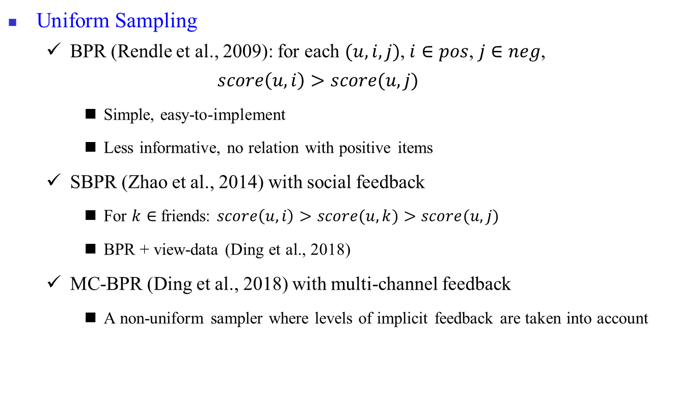
研究背景
相关工作
Uniform Sampling
BPR (Rendle et al., 2009): for each $(u, i, j)$, $i∈pos$, $j∈neg$,
$$score\left(u, i\right)>score(u,j)$$
Simple, easy-to-implement
Less informative, no relation with positive items
SBPR (Zhao et al., 2014) with social feedback
For $k∈$friends: $score\left(u, i\right)>score(u,k)$ $>score(u,j)$
BPR + view-data (Ding et al., 2018)
MC-BPR (Ding et al., 2018) with multi-channel feedback
A non-uniform sampler where levels of implicit feedback are taken into account
Zhao et al., Leveraging Social Connections to Improve Personalized Ranking for Collaborative Filtering, CIKM 2014.
Loni e al., Bayesian personalized ranking with multi-channel user feedback, RecSys 2016.
Ding et al, Sampler Design for Bayesian Personalized Ranking by Leveraging View Data, arxiv 2018, https://arxiv.org/pdf/1809.08162.pdf

Slide 4
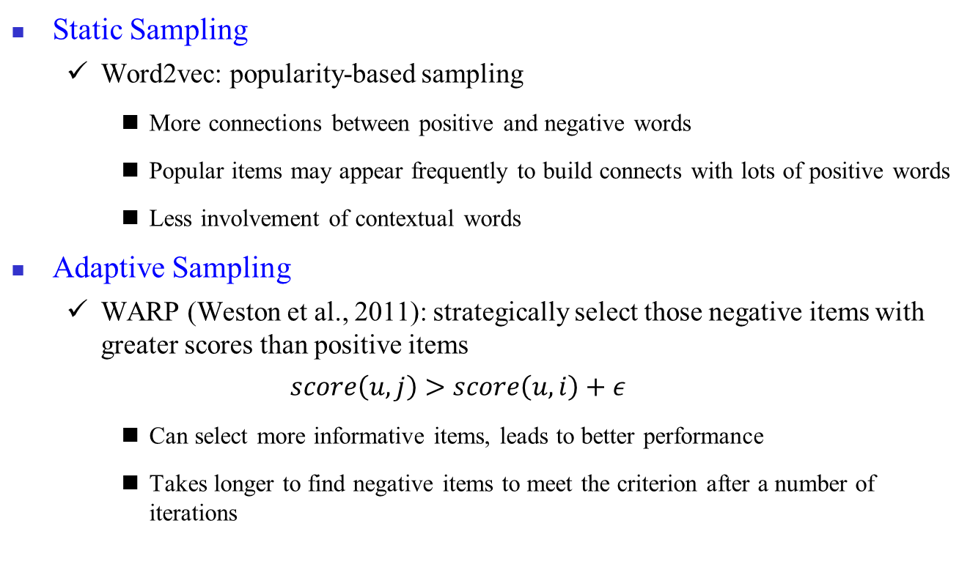
研究背景
相关工作
Static Sampling
Word2vec: popularity-based sampling
More connections between positive and negative words
Popular items may appear frequently to build connects with lots of positive words
Less involvement of contextual words
Adaptive Sampling
WARP (Weston et al., 2011): strategically select those negative items with greater scores than positive items
$$score\left(u,j\right)>score\left(u,i\right)+ε$$
Can select more informative items, leads to better performance
Takes longer to find negative items to meet the criterion after a number of iterations

Slide 5
研究背景
Negative Sampling for Neural Networks
Uniform sampling
Popularity-based sampling
GRU4Rec (Hidasi et al., ICLR 2016)
(Hidasi & Karatzoglou, CIKM 2018): Combining uniform and popularity
GAN for negative sampling
GAN for knowledge representation (Wang et al., AAAI 2018)
KBGAN (Cai & Wang, NAACL 2018)
AMF (He et al., SIGIR 2018)
Notes:
Hidasi & Karatzoglou, Recurrent Neural Networks with Top-k Gains for Session-based Recommendations, CIKM 2018
Wang et al., Incorporating GAN for negative sampling in knowledge representation learning, AAAI 2018
Cai and Wang, KBGAN: Adversarial Learning for Knowledge Graph Embeddings, arXiv 2018
He et al., Adversarial Personalized Ranking for Recommendation, SIGIR 2018

Slide 6
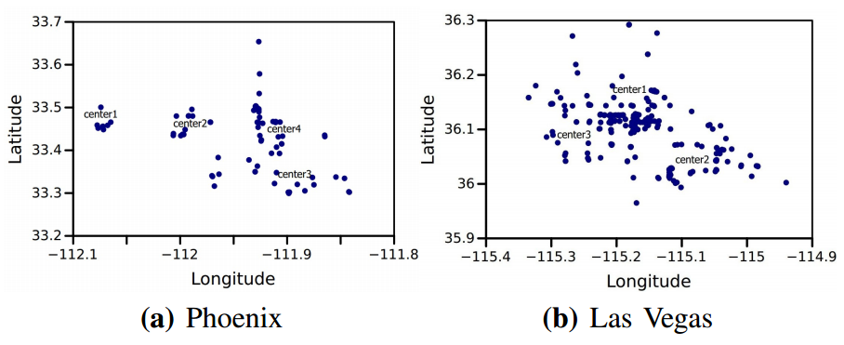
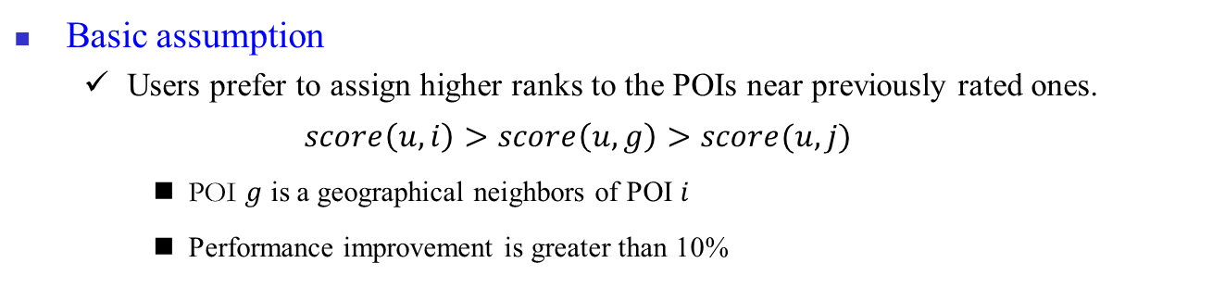
早期工作
GeoBPR for POI recommendation
Basic assumption
Users prefer to assign higher ranks to the POIs near previously rated ones.
$$score\left(u,i\right)>score\left(u,g\right)>score(u,j)$$
POI $g$ is a geographical neighbors of POI $i$
Performance improvement is greater than 10%
(ICTAI 2016, Best Student Paper)

Slide 7
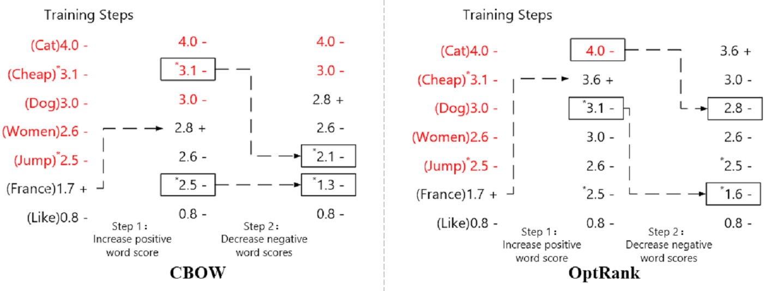
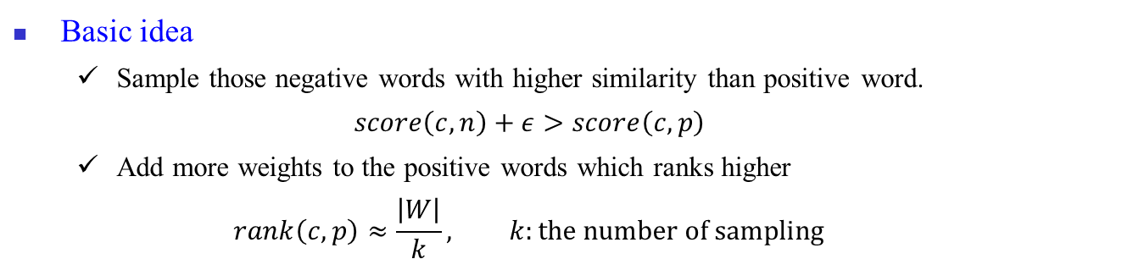
早期工作
OptRank over static sampling (IJCAI 2018)
Basic idea
Sample those negative words with higher similarity than positive word.
$$score\left(c,n\right)+ε>score\left(c,p\right)$$
Add more weights to the positive words which ranks higher
$$rank\left(c,p\right)≈\frac{\left|W\right|}{k}, k:the number of sampling$$
Notes:
The word denoted with symbol ‘*’ means that it is a popular word in the corpus. And the red words are the negative words which have higher scores than the positive word. Both models first increase the ranking scores of positive words (step 1) and then decrease the ranking scores of negative words (step 2)

Slide 8
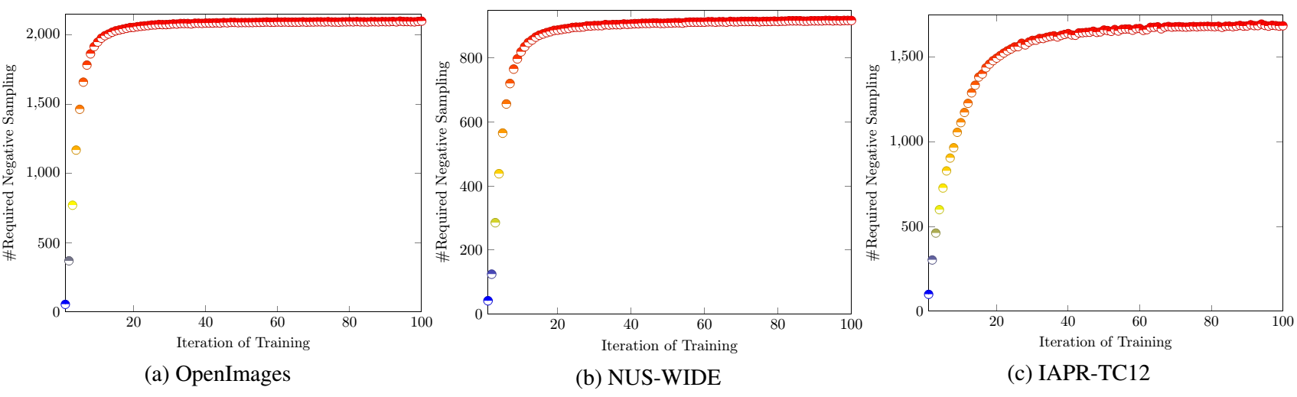
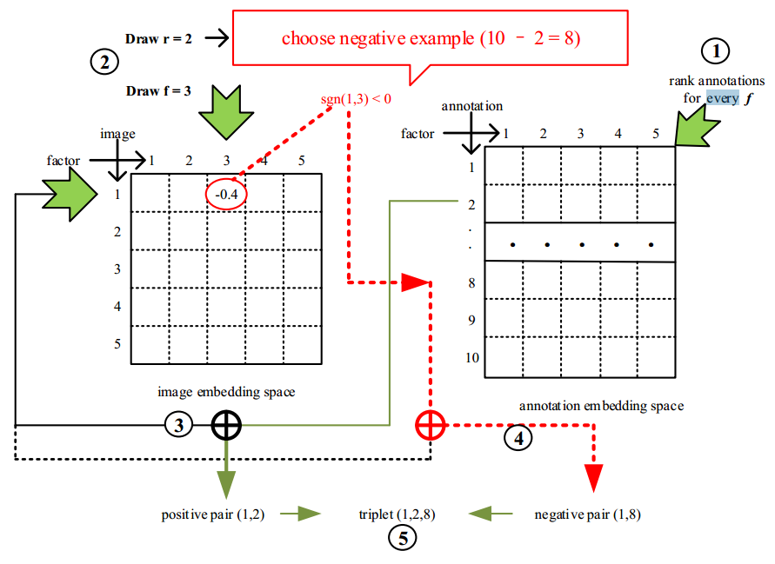
早期工作
VSE-ens to boost adaptive sampling (AAAI 2018)
问题：随着SGD迭代，负采样次数显著增加。方案：Fast Sampling Algorithm
Figure: Example of our adaptive negative sampling
Notes:
Following Algorithm 1, our model will rank these annotations according to va,f for each dimension f, and compute the value of σ_f and μ_f at the first iteration. Then, it will randomly choose a positive image-annotation pair, e.g. the 1st image and the 2nd annotation, denoted as (1,2). After this, the negative sampler will sample a rank r, e.g. r =2 according to the designed distribution and a dimension f, e.g. f =3. Finally, we are able to return the negative example according to sgn(v1,3), i.e., choosing the negative annotation from the ranked list with r=8, f=3 if sgn(v1,3)<0, and r=2, f=3 if sgn(v1,3)>0.

Slide 9
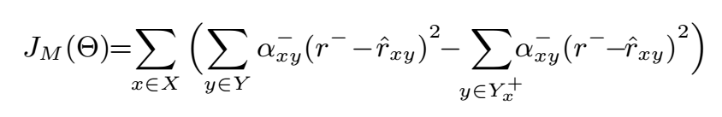
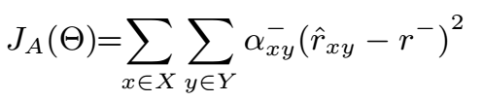

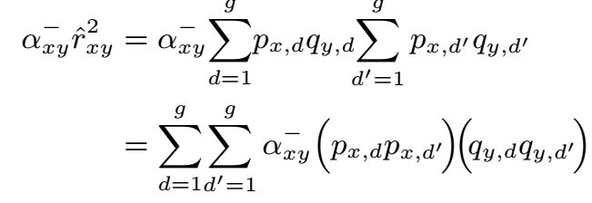
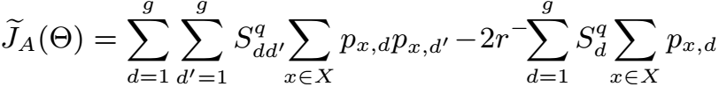
早期工作
fBGD with efficient full-sample (UAI 2018)
问题：采样可能会错过有用的物品，造成信息损失。方案：使用全数据集，不采样。
结论
通过分割非正样本的计算，
提前计算并缓存部分梯度，
可有效加快模型收敛的速
度，提升推荐的准确性。

Slide 10
研究工作一：IPGAN
IPGAN (IEEE Trans. on Neural Networks and Learning Systems, 2020)
Top-N Recommendation
Item pair (pos > neg)
Issues of classical negative sampling
Merely treat observed items as positive instances
ignoring the potential ones from the non-observed items;
ignoring the potential noise existing in the observed items;
Fail to capture the relationship between positive and negative items
cause the unexpected selection of potential positive items as negative ones.
Notes:
Guibing Guo, Huan Zhou*, Bowei Chen*, Zhirong Liu, Xiao Xu, Xu Chen, Zhenhua Dong, Xiuqiang He (2020), IPGAN: Generating Informative Item Pairs by Adversarial Sample, IEEE Transactions on Neural Networks and Learning Systems (TNNLS), accepted, (2020-9-25), https://ieeexplore.ieee.org/document/9240960

Slide 11
研究工作一：IPGAN
IPGAN (IEEE Trans. on Neural Networks and Learning Systems, 2020)
Main Idea
Informative item pairs need to consider the relationship between (potential) positive and negative items.
Positive items should be involved in the process of negative sampling
The approach
positive sampling: according to the distribution of overall features of observed items
negative sampling: according to the ranking scores of non-observed items.

Slide 12
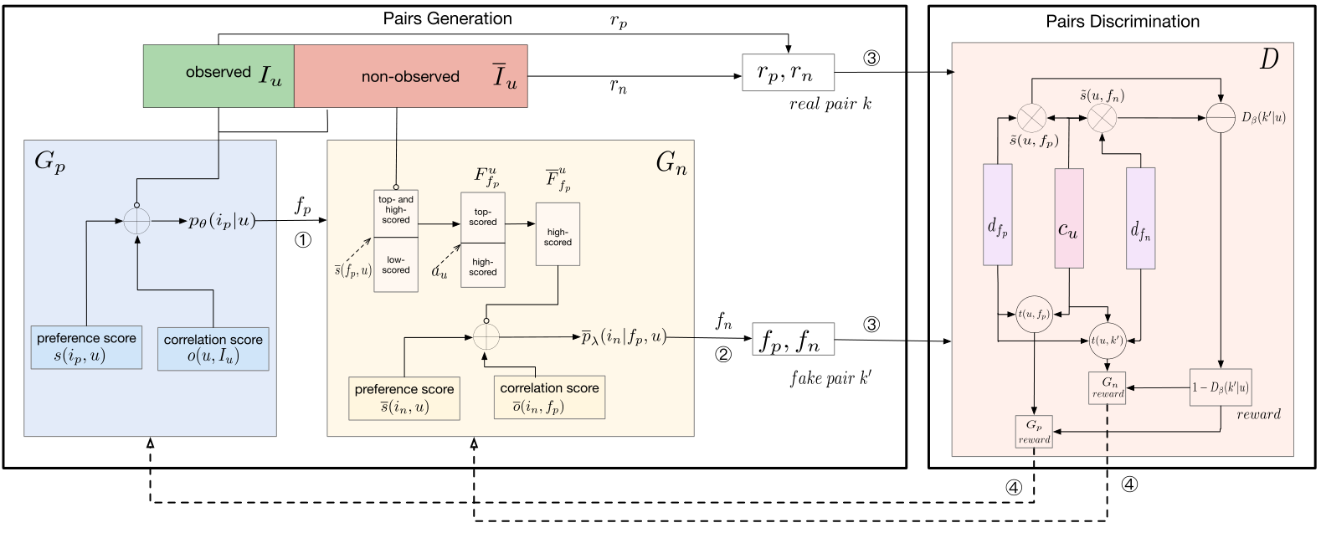
研究工作一：IPGAN
IPGAN (IEEE Trans. on Neural Networks and Learning Systems, 2020)
Workflow of our IPGAN model

Slide 13
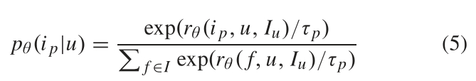
研究工作一：IPGAN
IPGAN (IEEE Trans. on Neural Networks and Learning Systems, 2020)
Positive Sampling

Slide 14
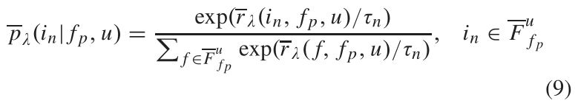
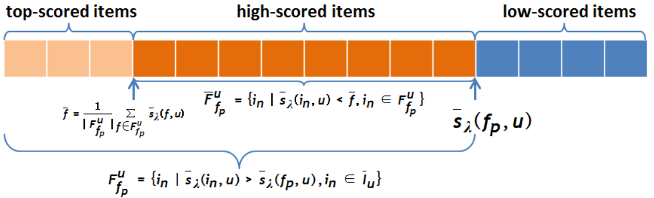

研究工作一：IPGAN
Negative Sampling
Finding the item whose ranking score (with user u) is higher than the positive instance $f_{p}$
Notes:
We claim that high-scored items are more informative and helpful than the top-scored ones in pairwised negative sampling. Yu et al. [15] pointed
out that a top-scored negative instance is likely to be interacted with user u in a normal situation and thus can be regarded as a potential positive instance.
According to our empirical study, these top-scored items will result in performance drop more severely even than the low-scored ones.

Slide 15
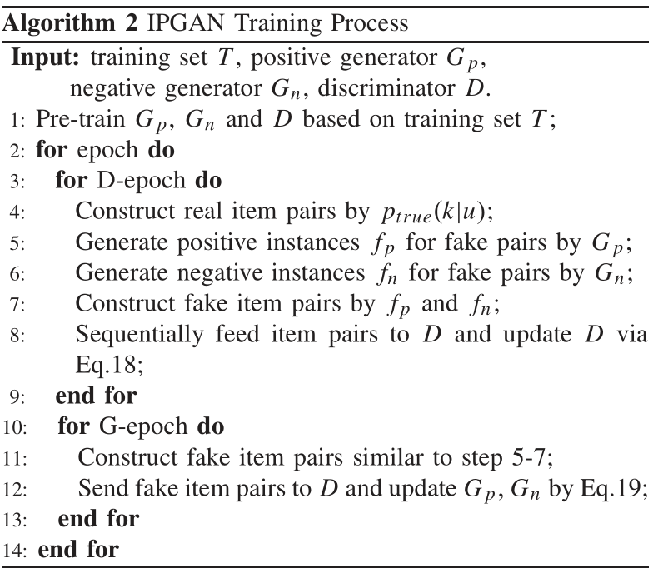
研究工作一：IPGAN
Model Training
Gradient policy update

Slide 16
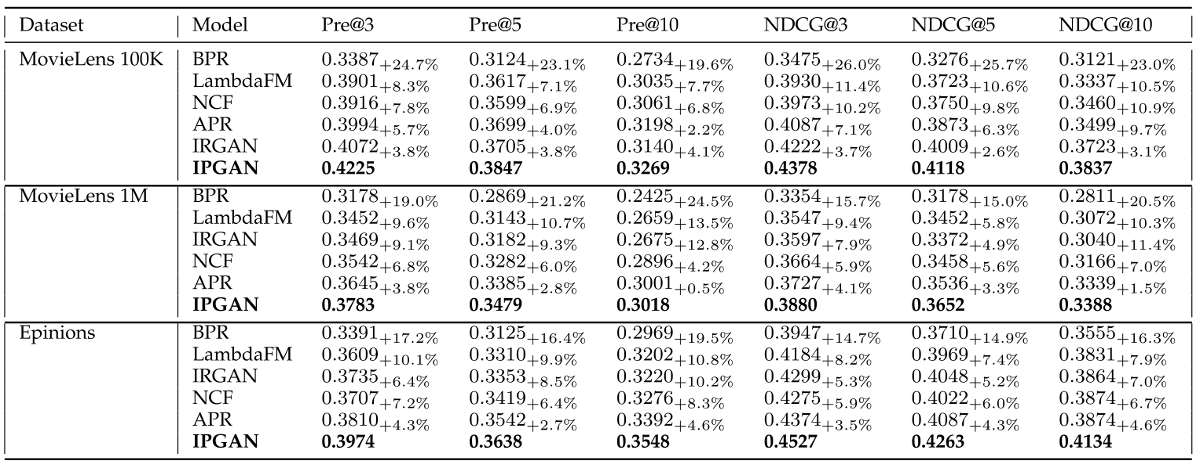
研究工作一：IPGAN
Experimentation
Notes:
APR [22] improves the BPR method by incorporating adversarial training. It adopts the same sampling strategy as BPR and removes user bias by adding adversarial perturbations on the representations of users and items.

Slide 17
研究工作二：path2rec
path2rec (IEEE Intelligent Systems, 2020)
Issues of existing GANs-based recommendation
Data-sparsity & cold-start problems
IRGAN: a same user-item pair for D may be labelled differently (sometime as the real pair, sometimes as generated), leading to over-early converged.
CFGAN: infeasible to deal with large datasets, spatial complexity up to O(mn)
A graph-based solution:
Construct heterogenous network with auxiliary information, i.e., social networks and item genre
Smart walk to build connections between users and items by GAN;
Spatial complexity is O(m+n)
Notes:
R. Ding, B. Chen, G. Guo*, X. Yang (2020). Adversarial Path Sampling for Recommender Systems. IEEE Intelligent Systems, accepted (2020/9/30). JCR: Q1; SCI: Q2; IF: 4.464.

Slide 18
研究工作二：path2rec
path2rec (IEEE Intelligent Systems, 2020)
Existing path sampling
random walk
node2vec: considering breadth-first & depth-first search (p, q)
metapath2vec: considering both local and global network for path sampling
KRPN: generating paths with a fixed length, long distant paths discarded
Issues:
require additional hyperparameters
only produce length-fixed paths, may ignore informative nodes.
Notes:
R. Ding, B. Chen, G. Guo*, X. Yang (2020). Adversarial Path Sampling for Recommender Systems. IEEE Intelligent Systems, accepted (2020/9/30). JCR: Q1; SCI: Q2; IF: 4.464.

Slide 19
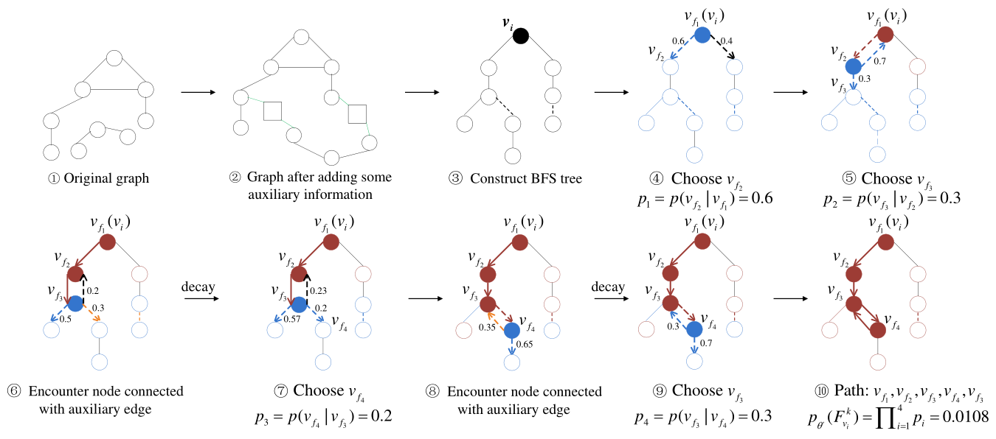
研究工作二：path2rec
Path Sampling Strategy
Notes:
To enhance the plausibility of the sampled paths, we propose the relevance decay strategy to reduce the dependencies between nodes that are not real.

Slide 20
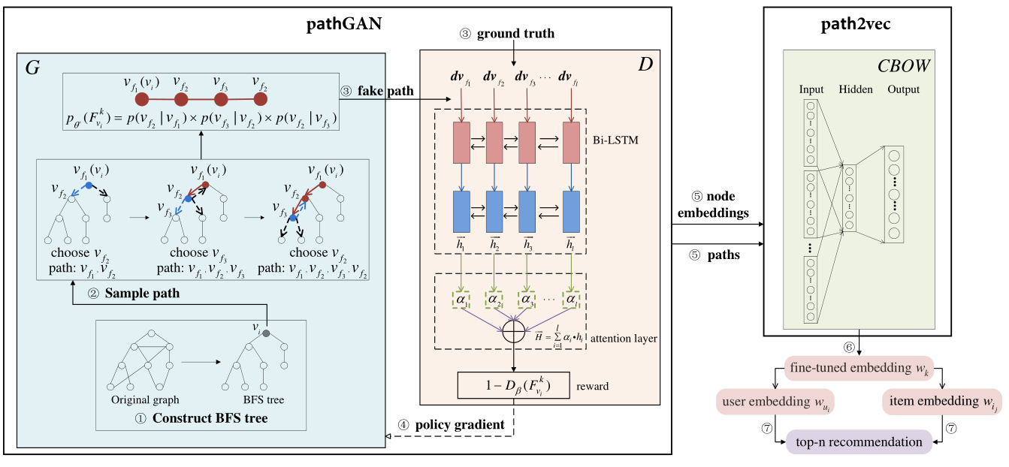
研究工作二：path2rec
The path2rec model

Slide 21
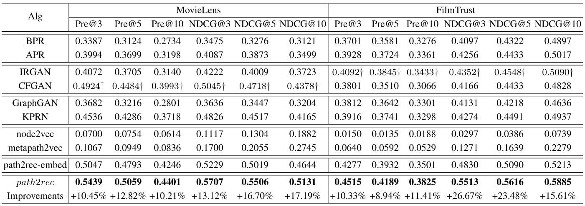
研究工作二：path2rec
Experimental Results
Network embedding for path sampling: node2vec, metapath2vec
Path-based methods: KPRN, GraphGAN

Slide 22
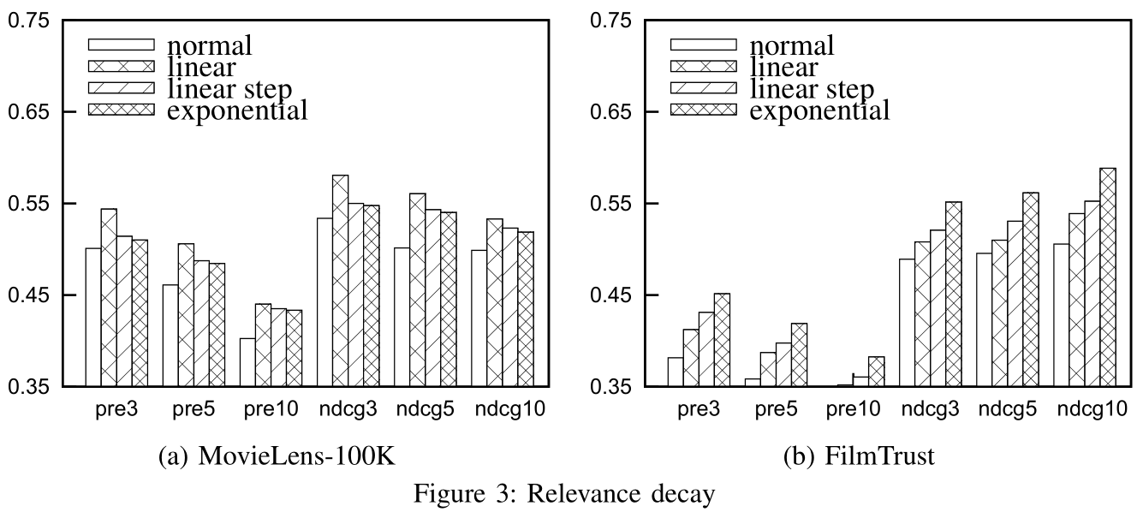
研究工作二：path2rec
Experimental Results
Relevance decay

Slide 23
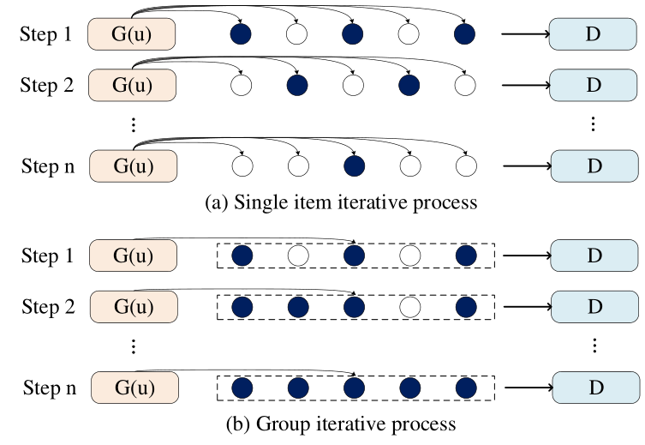
研究工作三：BiGAN
BiGAN (SDM 2020)
Issues of existing GANs-based recommendation
D could be misleading as G may sample real items as fakes ones
Fail to consider implicit friends (users with the same interest)
Notes:
R. Ding, B. Chen, G. Guo*, X. Yang (2020). BiGAN: Generating a Group of Items with Bidirectional Generative Adversarial Networks. In: Proceedings of the 20th SIAM International Conference on Data Mining (SDM), pp. 82-90.

Slide 24
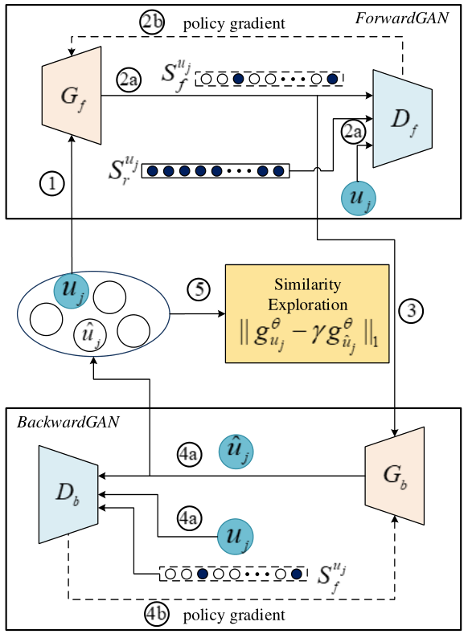
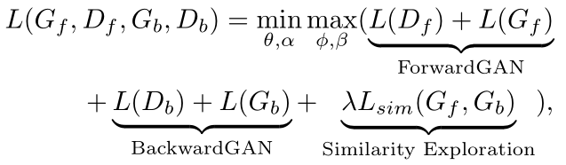
研究工作三：BiGAN
BiGAN (SDM 2020)
ForwardGAN
BackwardGAN

Slide 25
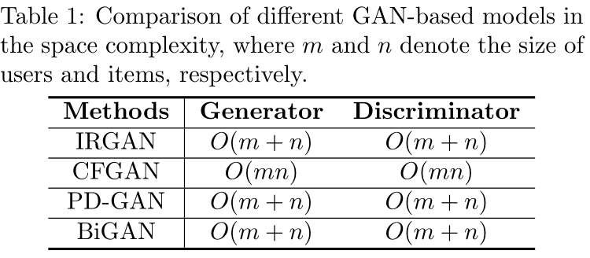
研究工作三：BiGAN
Space Complexity

Slide 26
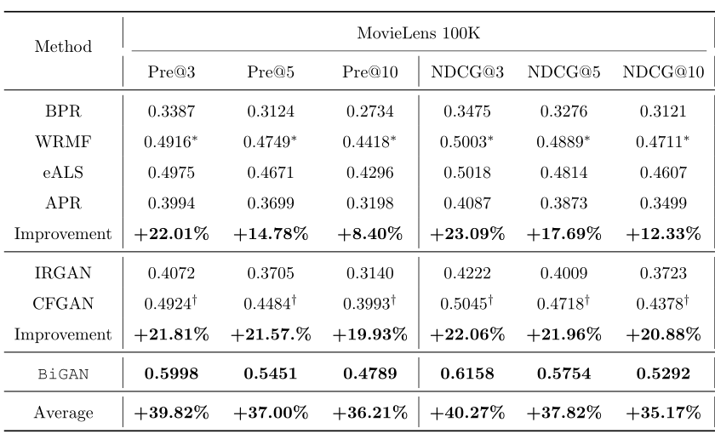
研究工作三：BiGAN
Experimental Results

Slide 27
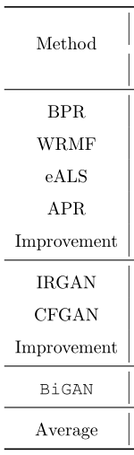
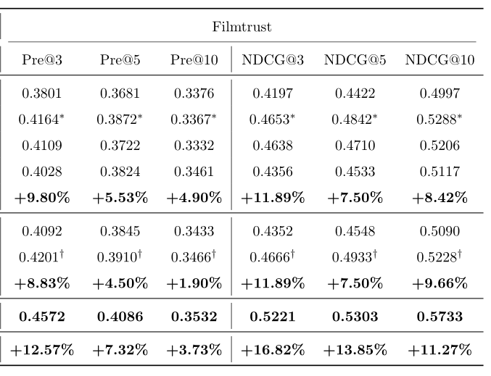
研究工作三：BiGAN
Experimental Results

Slide 28
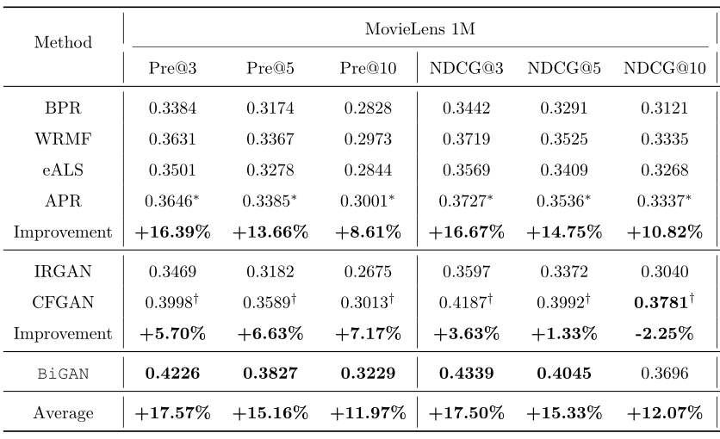
研究工作三：BiGAN
Experimental Results

